Slide 1
INTRODUCTION/HISTORY
Chapter 1
Notes:
LASAR and L.I.D.A.R. may be used interchangeably

Slide 2
MODULE CONTENT
Chapter 1: Introduction and History
Chapter 2: Scientific Principles
Chapter 3: Function
Chapter 4: L.I.D.A.R. Effects
Chapter 5: Set up
Chapter 6: Testing
Chapter 7: Legal Considerations

Slide 3
L.I.D.A.R.
ght
etection
nd
anging

Slide 4
L.A.S.E.R.
ight
mplification by
timulated
mission of
adiation

Slide 5
TYPES OF L.A.S.E.R.
Semiconductor
Gas
Chemical
Excimer
Free Electron

Slide 6
HISTORY OF L.A.S.E.R.S
Albert Einstein published paper On the Quantum Theory of Radiation
Valentin Fabrikant predicted use of stimulated emission to amplify light
Gordon Gould designed the first L.A.S.E.R. on paper
First Traffic
L.I.D.A.R. Developed
1917
1928
1939
1954
1957
1960
1989
Rudolph Ladenburg proved Einstein’s theory by confirming stimulated emission and negative absorption
Charles Towns, James Gordon, Herbert Zeigelk, developed MASER, microwave amplifier using stimulated emission
Theodore Maiman built first working L.A.S.E.R.
Notes:
In 1917 Albert Einstein, in his paper On the Quantum Theory of Radiation, laid the foundation for the invention of the L.A.S.E.R. and its predecessor, the maser, by introducing the concepts of probability coefficients (later to be termed 'Einstein coefficients') for the absorption, spontaneous emission, and stimulated emission of electromagnetic radiation. The paper proposed the phenomenon of stimulated emission, the basis for the LASAR
http://people.cas.uab.edu/~mirov/Lectures%201-2%20ch1%20fall%202015.pdf
http://people.seas.harvard.edu/~jones/cscie129/nu_lectures/lecture6/hertz/Hertz_exp.html
http://www.acs.psu.edu/drussell/Demos/doppler/doppler.html
https://micro.magnet.fsu.edu/optics/timeline/people/doppler.html

Slide 7
SCIENTIFIC PRINCIPLES
Chapter 2

Slide 8
DOPPLER PRINCIPLE
Based upon sound waves
Later determined to apply to other types of waves
“The frequency of a wave is relative to the motion between the source and the observer.”

Slide 9
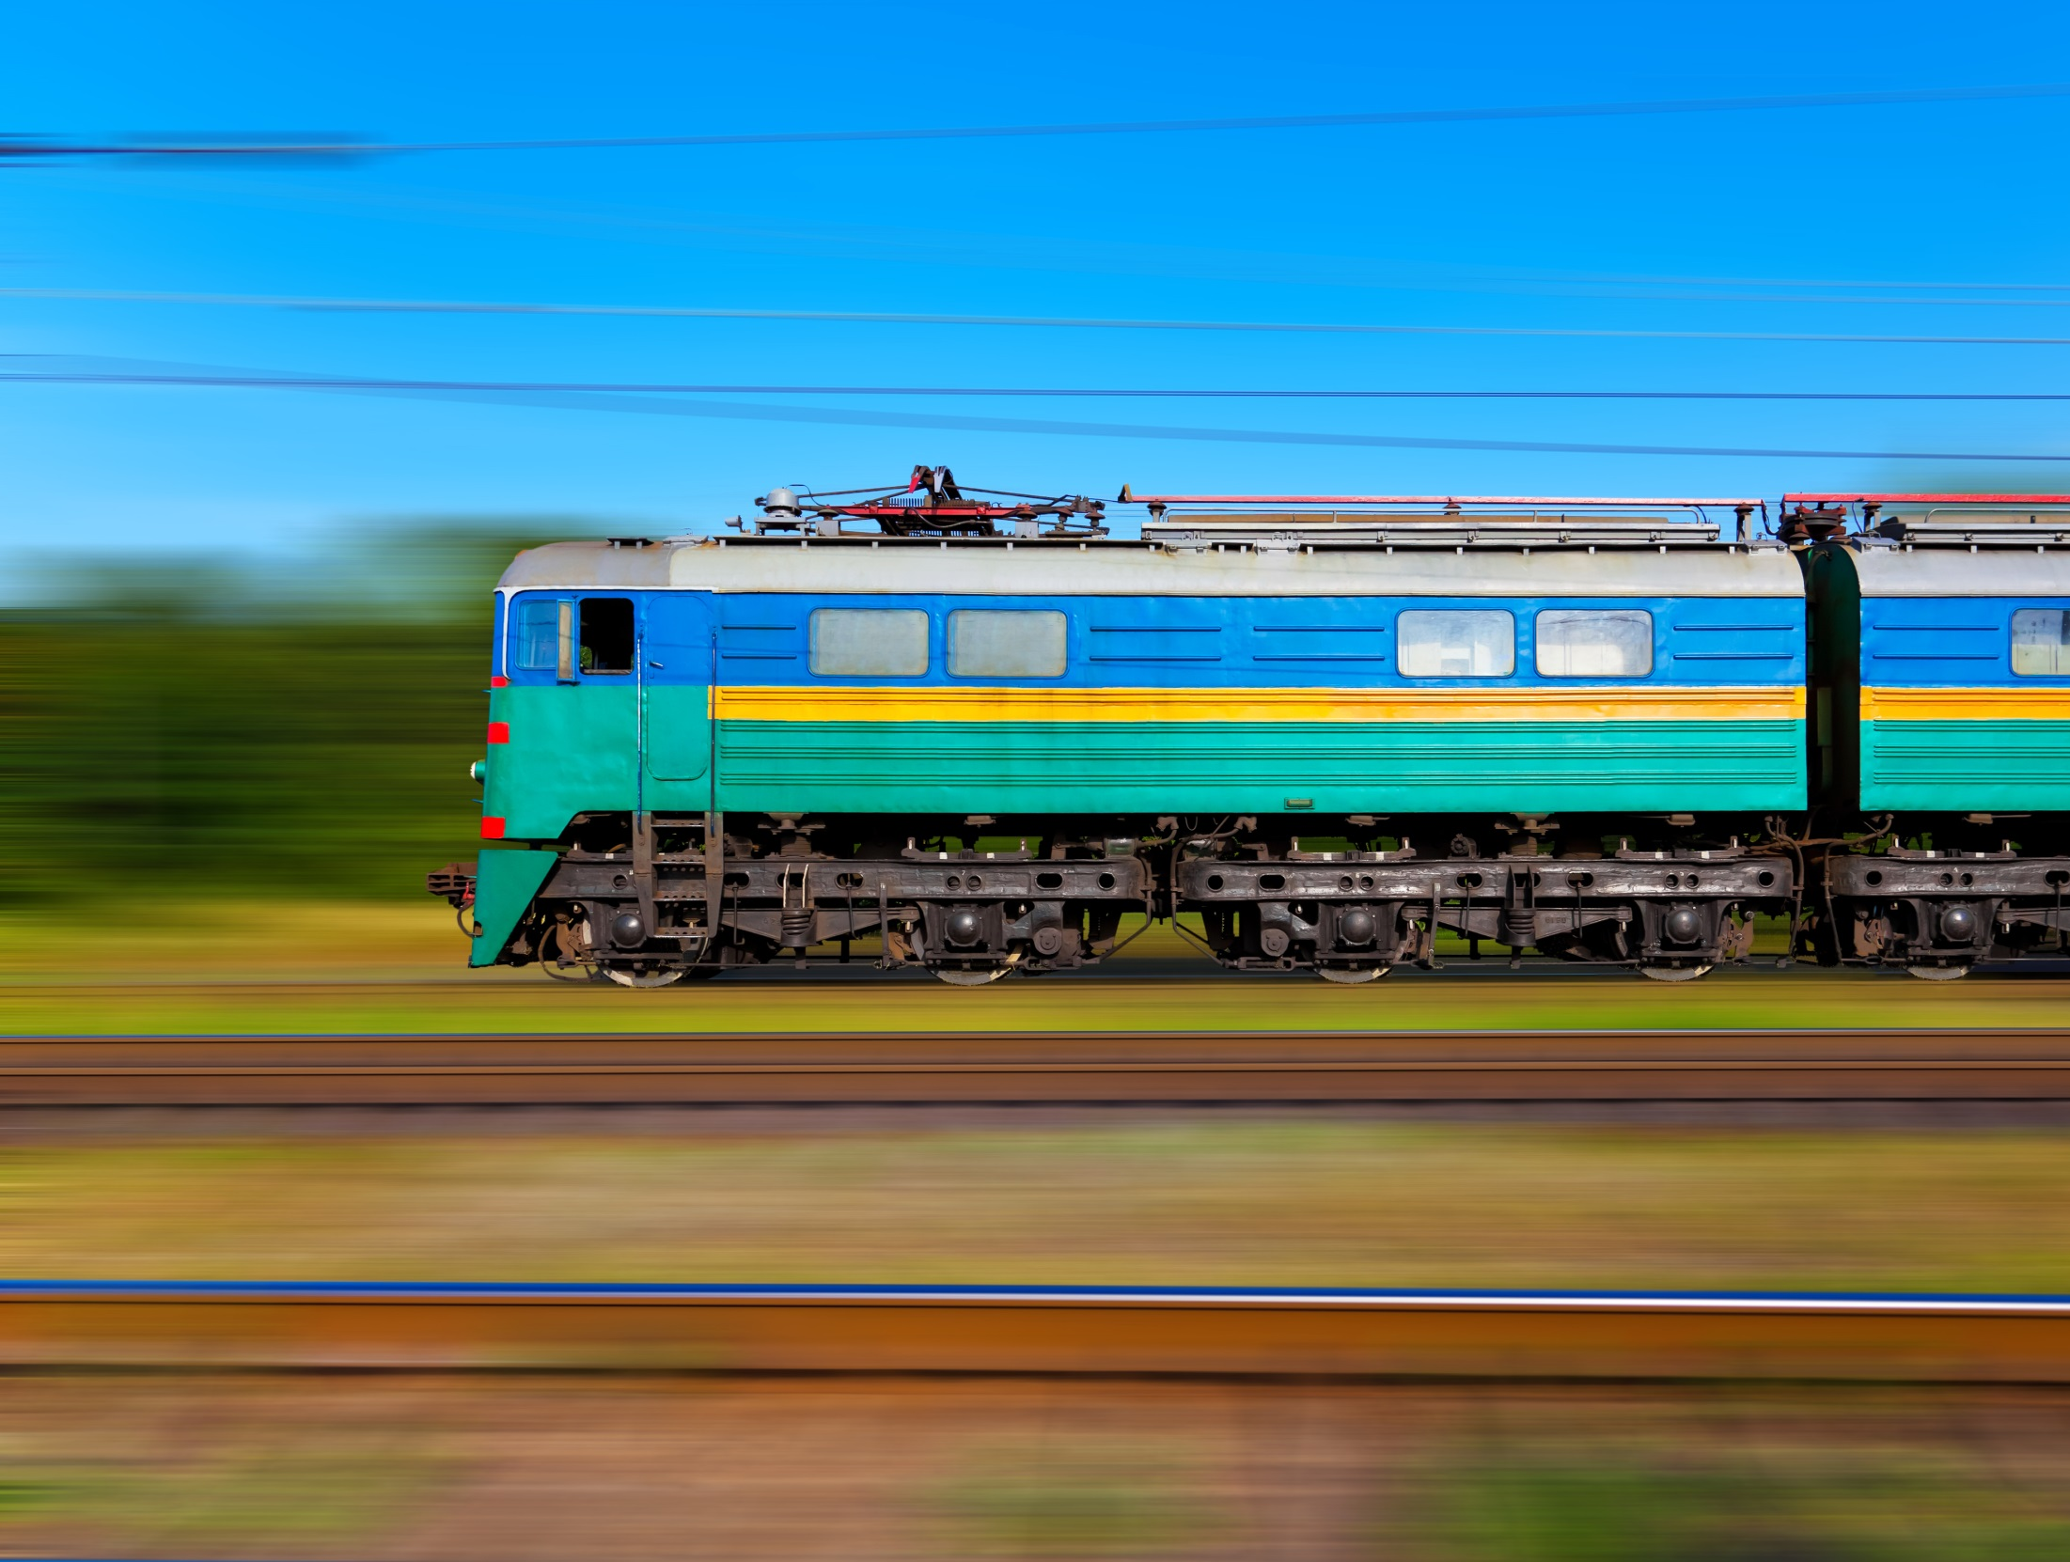
Higher Frequency
Lower Frequency

Slide 10
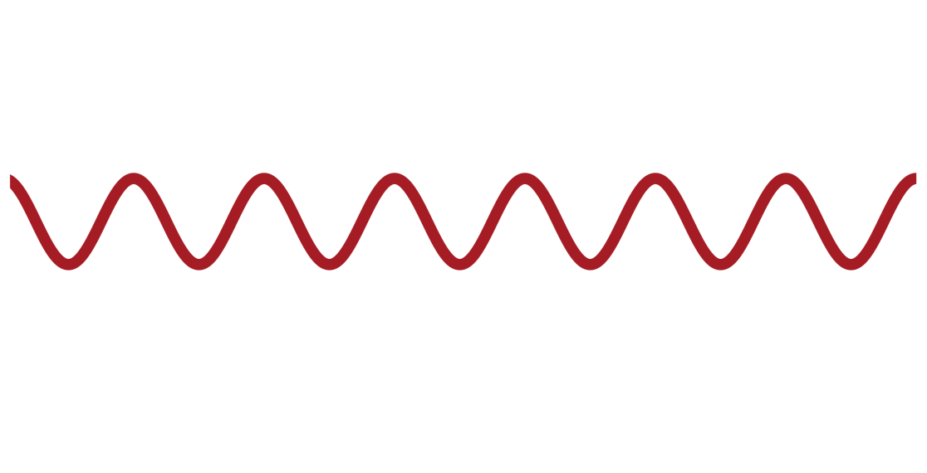
RELATIVE MOTION
Stationary
Objects Moving Towards
Objects Moving Away
Notes:
Needs updated graphics

Slide 11
L.I.D.A.R. USES LIGHT WAVES
Doppler principle (based on sound) also applies to:
Light Waves
Radio Waves

Slide 12
WAVE AND WAVELENGTH
Peak
A to B = WAVELENGTH
B
A
One Wave
Valley

Slide 13
TYPES OF WAVES & THEIR MEDIUMS
Ripple in pond, ocean waves: Water
Sound waves, blast waves: Air
Seismic waves (sound waves that travel through rock)
Electromagnetic waves: Space

Slide 14
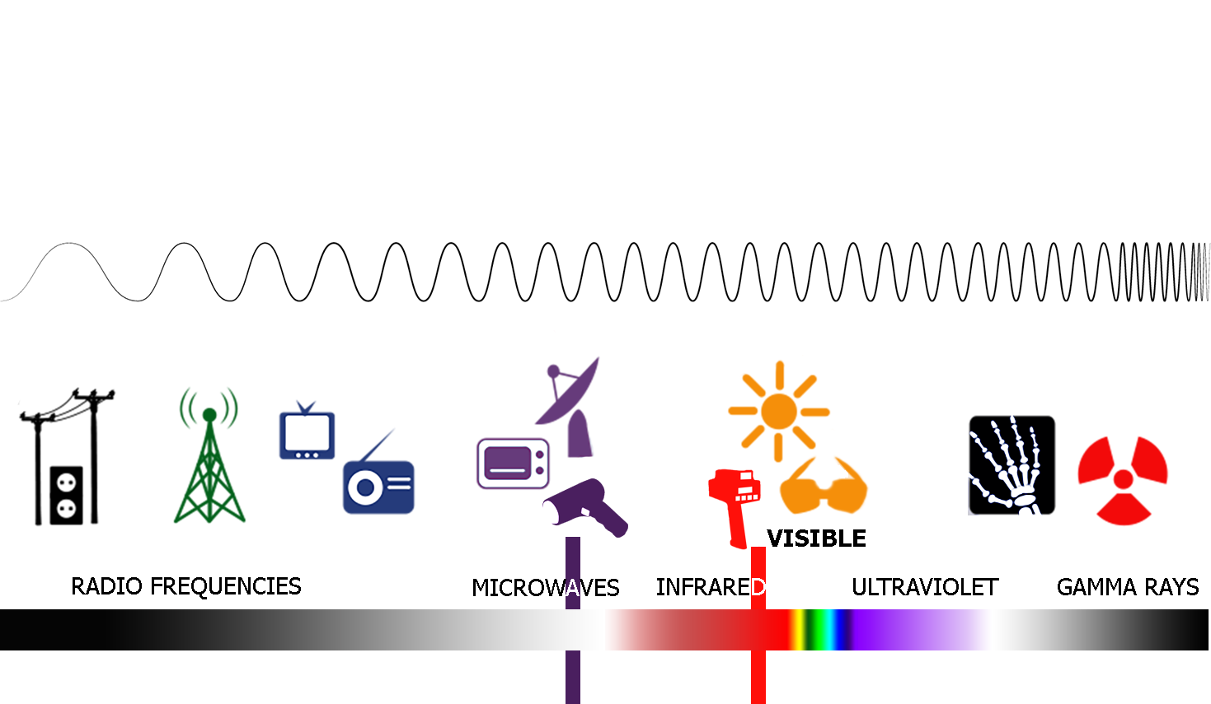
THE ELECTROMAGNETIC SPECTRUM
FREQUENCY INCREASE (CYCLES PER SECOND)
WAVELENGTHS DECREASE
X Band R.A.D.A.R. K Band R.A.D.A.R. Ka Band R.A.D.A.R.
(10.525 GHz) (24.15 GHz) (33.4 GHz-36 GHz)
L.I.D.A.R. (330 THz)

Slide 15
WAVELENGTH
The distance in which a periodic wave repeats itself
L.I.D.A.R. wavelength ≈ 904 to 905 nm
(Nanometer = Billionth of a Meter)

Slide 16
FREQUENCIES
L.I.D.A.R.
330 THz (terahertz)
R.A.D.A.R.
34.5 GHz
R.A.D.A.R.
24.150 GHz
R.A.D.A.R.
10.525 GHz
K-Band
X-Band
Ka-Band

Slide 17
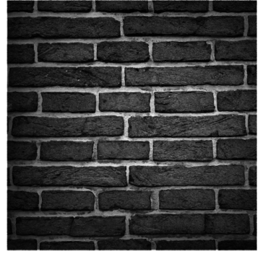
PROPERTIES OF LIGHT
Reflected
Metal
Concrete
Refracted
Glass
Absorbed
Grass
Earth
Sand

Slide 18
FUNCTION
Chapter 3

Slide 19
L.A.S.E.R.
ight
mplification by
timulated
mission of
adiation

Slide 20
CREATING L.A.S.E.R. LIGHT
Mirror
Light
Mirror
LIGHT AMPLIFICATION by STIMULATED EMISSION of RADIATION

Slide 21
OPTICAL RESONATOR
Lazing Medium

Slide 22
LASING MEDIUM
Crystals
Gases
Diodes

Slide 23
CONSISTENT PROPERTIES OF L.A.S.E.R.S TODAY
Limited divergence
Spreads slowly
Narrow spectrum
Occupies small portion of electromagnetic spectrum
High intensity
Heat or brightness

Slide 24
HOW L.A.S.E.R.S MEASURE DISTANCE
L.A.S.E.R. pulse travels from device
Reflects off target
Returns to the device
Knowing total time it takes pulse to travel can provide distance to object

Slide 25
SPEED OF LIGHT
186,282 miles per second
Convert to feet per second:
186,000 miles/second
X 5280 feet in a mile
982,000,000 feet/second
Speed of light =
186,282 miles per second
1 billion feet per second
1 foot every billionth of a second
1 FOOT EVERY NANO-SECOND

Slide 26
CHARACTERISTICS OF L.A.S.E.R. PULSES
Speed of a L.A.S.E.R. pulse is constant (speed of light)
Pulse width: duration / period of L.A.S.E.R. light pulse
Pulse repetition rate: number of pulses per second of transmission
Usually 100 to 300 pulses per second

Slide 27
HOW L.A.S.E.R.S MEASURE DISTANCE
Notes:
Recall the basic formula for a time/distance calculations is:
Through algebra we can change this formula to find a distance if time and speed is known.

Slide 28
HOW L.A.S.E.R.S MEASURE DISTANCE
The round trip time is 250 ns
The L.A.S.E.R. divides 250 ns in half to find time it took pulse to reach target
$$\frac{250}{2}=125ns$$
The L.A.S.E.R. reads this as 125 ft
Example 1:
A L.A.S.E.R. pulse travels to target in 125 ns
L.A.S.E.R. pulse travels back to L.A.S.E.R. in 125 ns

Slide 29
HOW L.A.S.E.R.S MEASURE DISTANCE
Example 2:
A L.A.S.E.R. pulse is transmitted towards a car 600 ft away
Round trip time for the pulse is 1200 ns (600 ft to the car, and 600 ft back)
Dividing the round trip time by 2 gives the distance to the car
1200 ns / 2 = 600 ns = 600 ft

Slide 30
L.I.D.A.R.
ght
etection
nd
anging

Slide 31
PROPERTIES OF L.I.D.A.R.S
Use gallium arsenide diodes
904 nm wavelength
Transmits beam for short time interval
L.A.S.E.R. pulse
Time of L.A.S.E.R. pulse
expressed in nanoseconds (ns)

Slide 32
BASIC L.I.D.A.R. COMPONENTS
Object
Beam Splitter
L.A.S.E.R.
Diode
On
Timer / Computer
Off
Beam Splitter

Slide 33
TIME OF FLIGHT
R.A.D.A.R.s use the change in frequency of a radio wave
The Doppler principle
L.I.D.A.R.s measure distance change over time
Measurement of the time is called Time of Flight

Slide 34
HOW L.I.D.A.R.S MEASURE SPEED
L.I.D.A.R.s take several distance readings over an interval of time
A target with relative motion will provide the L.I.D.A.R. with a new distance on each pulse
The L.I.D.A.R. calculates the change in distance over change in time: s = d / t

Slide 35
HOW L.I.D.A.R.S MEASURE SPEED
L.I.D.A.R.s can differentiate one pulse from another
Light travels very fast (one foot every 1 billionth of a second)
Time interval of pulses is very slow (approximately 300 pulses per second)
Notes:
If a L.I.D.A.R. fires 300 pulses per second, then for a returning pulse to meet a departing pulse, the round trip time for the returning pulse would be 3.3 million nano seconds or 3.3 million feet – approximately 631 miles!!!

Slide 36
HOW L.I.D.A.R.S MEASURE SPEED
Example 3:
Given target moving in relation to the L.I.D.A.R.
First pulse positions target at 400 feet
Pulse travels 800 ns round trip to target
L.I.D.A.R. divides 800 by 2 to get 400 ns:
400 ns = 400 feet
Second pulse positions target at 378 feet after 1/3 of a second
400 ft − 378 = 22 ft per 1/3 second
Speed = 66 ft/s or 45 mph
Notes:
CLICK ON LAST LINE FOR LINK.

Slide 37
HOW L.I.D.A.R.S MEASURE SPEED
Example 4:
1st target position – 900 ns
2nd target position – 922 ns
Time Interval – 1/3 s
Target Speed
Target Distance
Target Direction of Travel
45 MPH
922 Feet
Away

Slide 38
L.I.D.A.R. Beam Width
L.I.D.A.R.
18 in
36 in
0 ft
500 ft
1000 ft

Slide 39
BEAM WIDTHS
X – BAND
317 ft.
KA – BAND
157 ft.
L.A.S.E.R.
36 in.
K – BAND
210 ft.
0 ft
500 ft
1000 ft

Slide 40
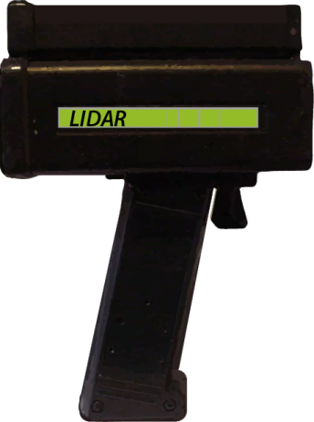
AVERAGE OF LEAST SQUARES
What if 1st pulse hits the windshield and 2nd pulse hits the grill?
An erroneous 4 feet gets added and would increase the violator's speed.

Slide 41
AVERAGE OF LEAST SQUARES
A process used to eliminate errors
Each pulse is mathematically plotted
Each new plot is compared with previous data

Slide 42
AVERAGE OF LEAST SQUARES
Distance
Allowed limits of data
Time
Vehicle Approaching
Notes:
Vehicle approaching is showing a shorter time for the pulse return. Vehicle coming at you, L.I.D.A.R. firing p

Slide 43
AVERAGE OF LEAST SQUARES
Sudden changes in targeting points can result in an erroneous speed display
This data would fall outside the limits set by the L.I.D.A.R.
Speed reading not displayed during time data falls outside limits

Slide 44
AVERAGE OF LEAST SQUARES
Distance
Reflection from
Windshield
Reflection
From grill
Time
Vehicle Approaching

Slide 45
AVERAGE OF LEAST SQUARES
Distance
Trapped and deleted
Data
Time
Vehicle approaching
Notes:
Average of least

Slide 46
L.I.D.A.R. TARGETING
Reflective surfaces
Color
Cleanliness
Distance
Texture

Slide 47
AIMING POINTS ON VEHICLE

Slide 48
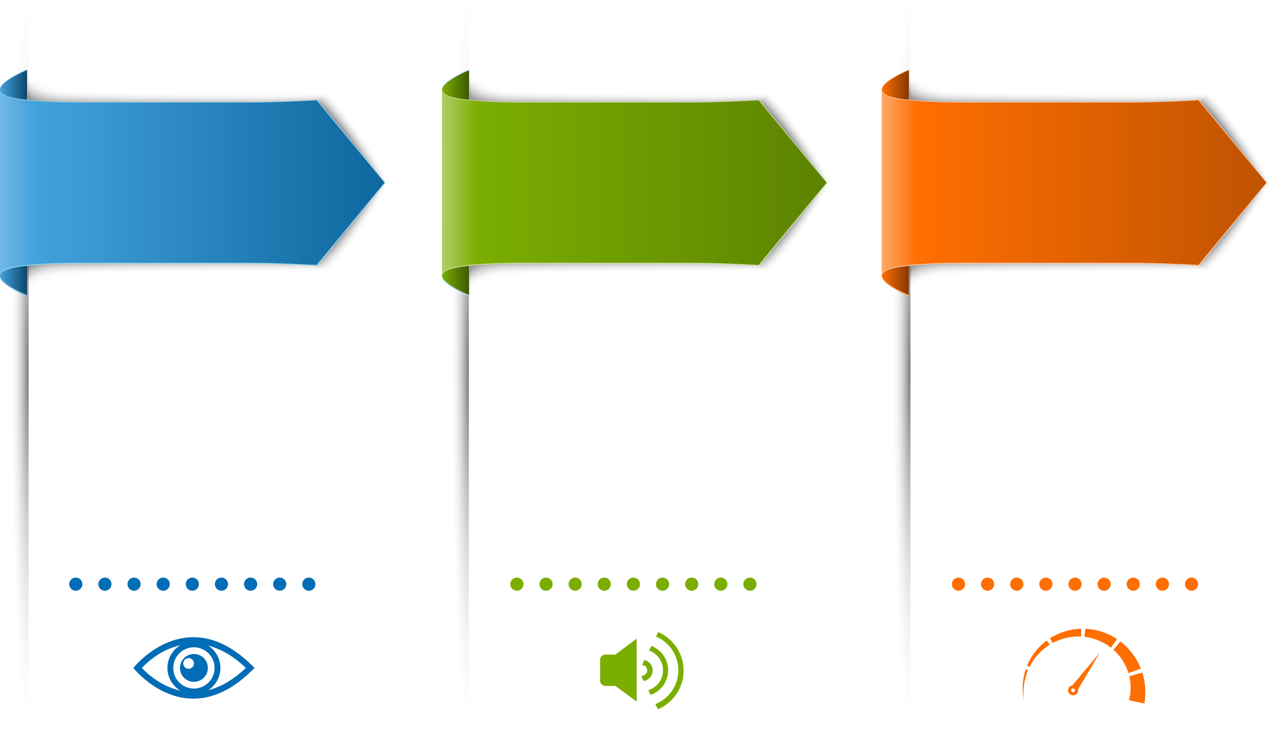
L.I.D.A.R. TRACKING HISTORY
VISUAL OBSERVATION
AUDIO CONFIRMATION
UNIT CONFIRMATION
Target Identification
Speed Estimation
Target Range
Check Environment
Varies with device
Consistent with visual estimate
Steady reading

Slide 49
L.I.D.A.R. EFFECTS
Chapter 4

Slide 50
FACTORS AFFECTING L.I.D.A.R.
Radio Frequency Interference (R.F.I.)
Random R.F.I.
Law Enforcement Radio R.F.I.
Light Devices R.F.I.
Electrical Lines R.F.I.

Slide 51
FACTORS AFFECTING L.I.D.A.R.
Windshield
Weather
Low Voltage
Sweep Effect
Cosine Effect

Slide 52
SWEEP EFFECT
Caused by changing targeting point while transmitting L.A.S.E.R. pulses
Creates gradual change in speed data instead of sudden change
L.I.D.A.R. may allow data in and see the change as an increase in speed depending on how wide the limits are set in the average of least squares error trappings

Slide 53
SWEEP EFFECT
Distance
True target speed
Time
Change in target speed due to movement of L.I.D.A.R.

Slide 54
SWEEP EFFECT

Slide 55
SWEEP EFFECT
Vehicle Moving
May produce momentary speed reading higher than actual speed!

Slide 56
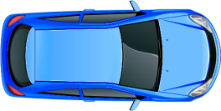
STATIONARY COSINE EFFECT
0
35
46
49
True Target Speed = 50 mph
°
22
°
Cosine of 22 = .92
50 mph x .92 = 46.3 mph
True Speed = 50 mph
Indicated Speed = 46 mph

Slide 57
COSINE EFFECT
True Speed as Affected by the Cosine Effect
Angle Degrees | 30 mph | 40 mph | 50 mph | 55 mph | 60 mph | 70 mph
0 | 30.00 | 40.00 | 50.00 | 55.00 | 60.00 | 70.00
1 | 29.99 | 39.99 | 49.99 | 54.99 | 59.99 | 69.99
3 | 29.96 | 39.94 | 49.93 | 54.92 | 59.92 | 69.90
5 | 29.89 | 39.85 | 49.81 | 54.79 | 59.77 | 69.73
10 | 29.54 | 39.39 | 49.24 | 54.16 | 59.09 | 68.94
15 | 28.98 | 38.64 | 48.30 | 53.12 | 57.94 | 67.61
20 | 28.19 | 37.59 | 46.99 | 51.68 | 56.38 | 65.78
30 | 25.98 | 34.64 | 43.30 | 47.63 | 51.96 | 60.62
45 | 21.21 | 28.28 | 35.36 | 38.89 | 42.43 | 49.50
60 | 15.00 | 20.00 | 25.00 | 27.50 | 30.00 | 35.00
90 | 0.00 | 0.00 | 0.00 | 0.00 | 0.00 | 0.00

Slide 58
L.I.D.A.R. JAMMER
Presence of L.I.D.A.R. jammer may be recognizable when:
Operating range is reduced
Error code displayed
No speed displayed

Slide 59
SET UP
Chapter 5

Slide 60
L.I.D.A.R. OPERATIONAL CONSIDERATIONS
Pre-Operational
Visual inspection of instrument
Transportation considerations
Function check of instrument

Slide 61
TESTING
Chapter 6

Slide 62
LIGHT TEST
Ensures individual light segments and indicators are functioning properly

Slide 63
INTERAL TESTING
Internal Circuit Check

Slide 64
EXTERNAL TESTING
Sight Alignment
Range
Delta Distance

Slide 65
L.I.D.A.R. HEALTH CONCERNS
Safe for human exposure
Never stare directly into device lens
Never stare directly into device lens within 50 feet of device using binoculars, telescope, or other optical gain devices

Slide 66
LEGAL CONSIDERATION
Chapter 7

Slide 67
FUNDAMENTAL CASE LAW AFFECTING L.I.D.A.R.
Evidence must be ruled admissible
Sufficient reason to believe evidence is valid
Question concerning validity of L.I.D.A.R.:
Is the measurement an accurate representation of the vehicle speed driven by the accused at the time of alleged violation?

Slide 68
WHAT IMPACTS ACCEPTANCE OF L.I.D.A.R.
Do we know that the operating principles of L.I.D.A.R. are valid?
Do we know that the L.I.D.A.R. device was working properly at the time of the alleged violation?
Do we know that the operator has the necessary qualifications and performed properly at the time of the alleged violation?
Do we know that the speed measurement came from the vehicle driven by the accused?

Slide 69
HONEYCUTT V. COMMONWEALTH
Kentucky stationary R.A.D.A.R. case
Addressed operator qualifications
Operator not required to explain internal workings of the device
Knowledge of scientific principle irrelevant to operation of a speed measurement device
Established that operator will have made visual estimate of target vehicle speed

Slide 70
LESSONS LEARNED
L.I.D.A.R. Challenges and Discovery
A 2008 case in New Jersey based on a L.I.D.A.R. citation, resulted in the conviction being reversed and remanded based on failure to comply with the following:
Providing copies of both sides of the citation and any notes made regarding the stop
A description of the speed-measuring device, make and model
The officer’s training history on the R.A.D.A.R. device; where he was trained and by whom; and manufacturer’s manuals for the device
Training manuals for the State of New Jersey and operating procedure for the speed-measuring device
Officer‘s log showing what citations were issued that day
Repair history of the speed-measuring device for the last 12 months
Any engineering and speed study used to set the speed limit.
State v. Green,417 N.J. Super.190th , 9A.3d 172, 2010 N.J. Super. LEXIS 213 (App.Div.2010)

Slide 71
IMPACT OF NEW PRODUCTS
L.I.D.A.R. is accepted in most courts and will be received by judicial notice
When a new product is used, a Court can be demanding
State v. Sweat, 2016-Ohio
On appeal, the court defined the requirements for acceptance of a new device, and noted they had not been met
State specific requirements are important in case preparation
State v. Sweat, 2016-Ohio-2680 *, 2016 Ohio App. LEXIS 1548 (Ohio Ct. App., Butler County Apr. 25, 2016)
State v. Helke, 2015-Ohio-4402, 46 N.E.3d 188, 2015 Ohio App. LEXIS 4267 (Ohio Ct. App., Montgomery County 2015)

Slide 72
PEOPLE V. DE PASS (1995)
Challenged proper use of L.I.D.A.R.
Court identified proper officer training and before and after testing

Slide 73
HAWAII V. ABIYE ASSAYE (2009)
Defendant cited for 90 mph in a 55 mph zone based on L.I.D.A.R. device measurement
Insufficient foundation was laid to admit the measurement based on:
Officer’s training did not meet manufacturer’s requirements, even thought the officer was trained in L.I.D.A.R. operation
With no other evidence to support the defendant’s speed; there was no way to support a conviction

Slide 74
MEETING THE NEEDS FOR JUDICIAL NOTICE
Ensure officer’s training is well documented and meets all State or local requirements
Ensure all training requirements and standards for a particular device are met and can be demonstrated
Maintain the operator’s manual for the device in an appropriate format for easy reference and confirmation of information
Review and assess potential for challenges to new devices with appropriate authority, e.g. prosecutor’s office, court
Ensure all documentation is available, including maintenance records for each speed-measuring device

Slide 75
SUMMARY AND SECTION REVIEW

