Slide 1
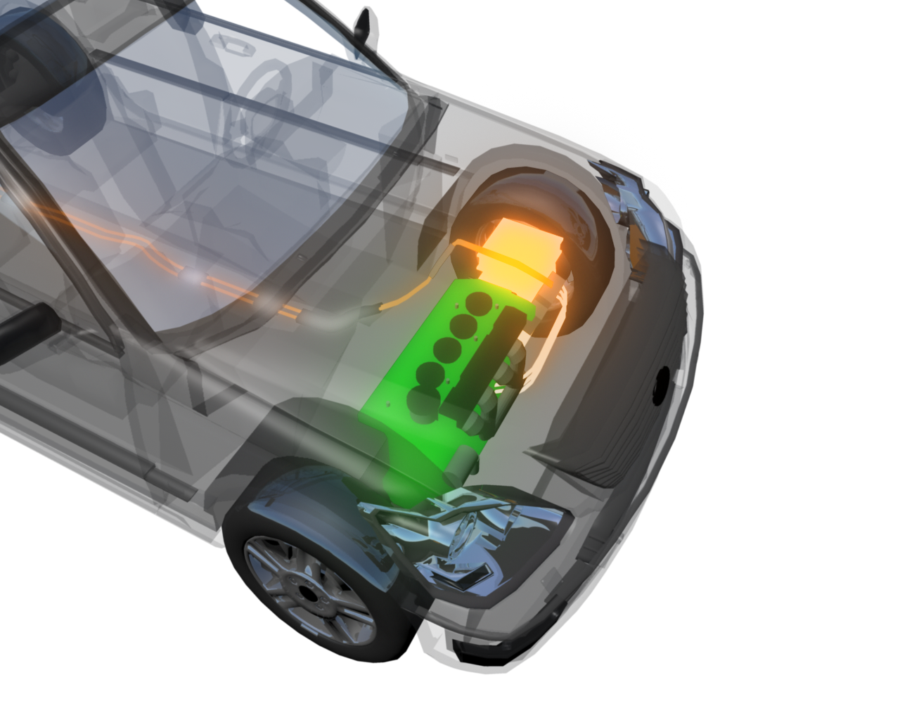
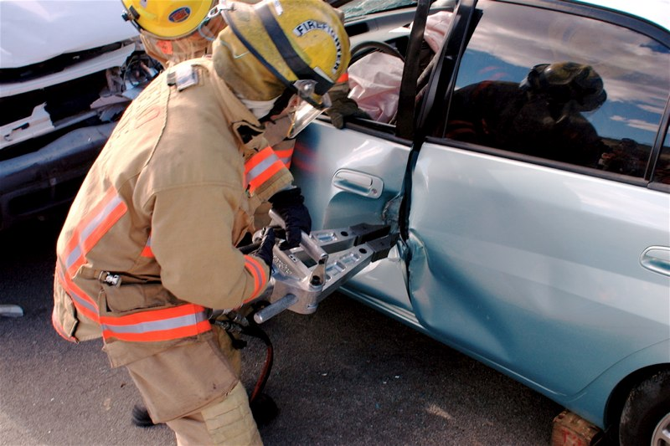
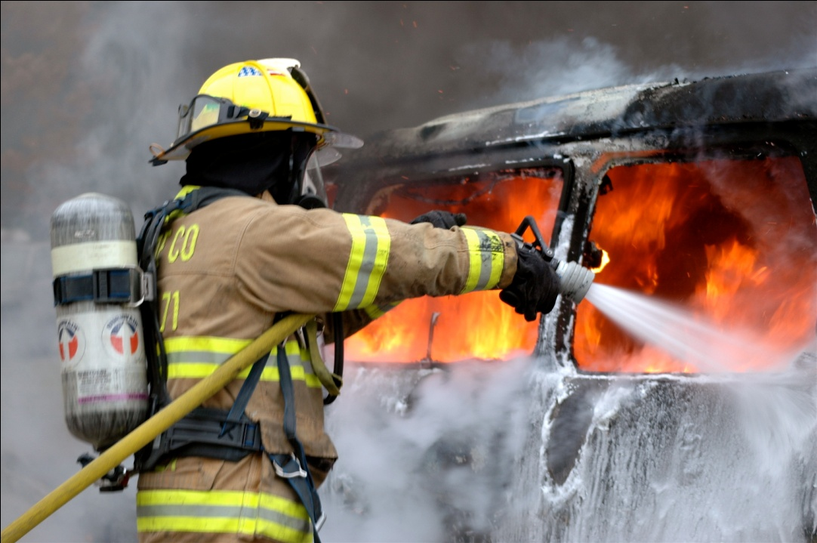
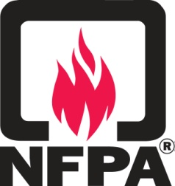
National Fire Protection Association
ELECTRIC
VEHICLE SAFETY TRAINING FOR EMERGENCY RESPONDERS
Christian Dubay, P.E.
Vice President & Chief Engineer

Slide 2
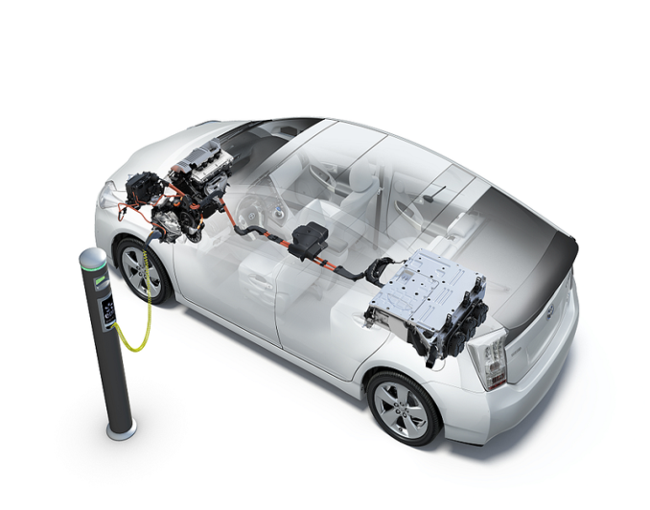
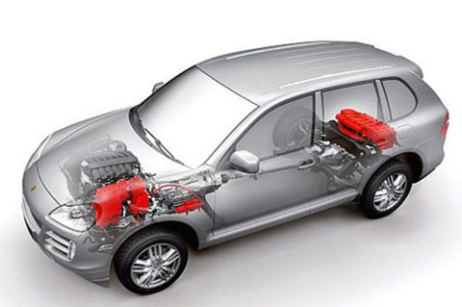
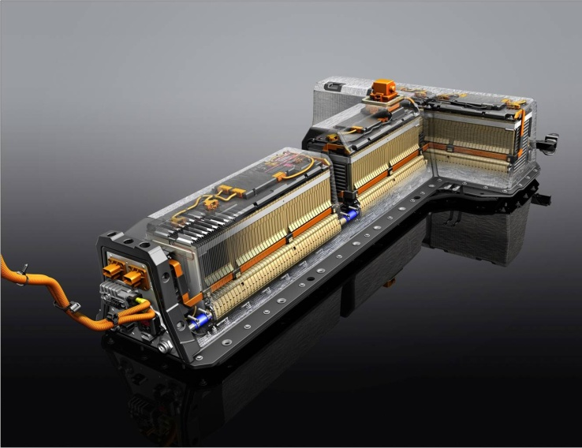
EV Safety Training Project Scope
Plug in Hybrids
Electric
Hybrids
Courtesy Toyota Motor, N.A.,Inc.
Courtesy BYD
Courtesy Ford Motor Co.
Courtesy Porsche Cars N.A., Inc.
Emergency Operation
Procedures
High Voltage Vehicle Safety Systems
AC & DC Charging Stations
Image courtesy of Porsche

Slide 3
North American Fire Training Directors (NAFTD)
International Association of Fire Fighters (IAFF)
International Association of Fire Chiefs (IAFC)
National Volunteer Fire Council (NVFC)
International Fire Marshals Association (IFMA)
National Association of State Fire Marshals (NASFM)
Metropolitan Fire Chiefs
U.S. Fire Administration (USFA)
National Highway Traffic & Safety Administration (NHTSA) – Emerging Issues
National Renewable Energy Lab (NREL) – Tech Questions & Trends
State Farm Insurance – Safety Issues, Crash Test Results
Training Developed with Assistance from:

Slide 4
Auto Manufacturer Partnerships
Alliance of Auto Manufacturers (AAM)
Association of Intl Auto Manuf. (AIAM)
16 Auto Manufacturer Partnerships
General Motors Honda
Ford Mitsubishi
Toyota Chrysler
Nissan Volkswagen
Porsche BMW
Hyundai Kia
Tesla Mercedes
Mazda Alt-e

Slide 5
Fire Service Training Delivery
NFPA EV Safety Website and Self-Paced Online Training
NFPA Train-the-Trainer (Train instructors each state)
University and Tech College Partners
Fire Service Organization Partnerships
State Fire Service Trainers
Fire Fighters in the Field

Slide 6
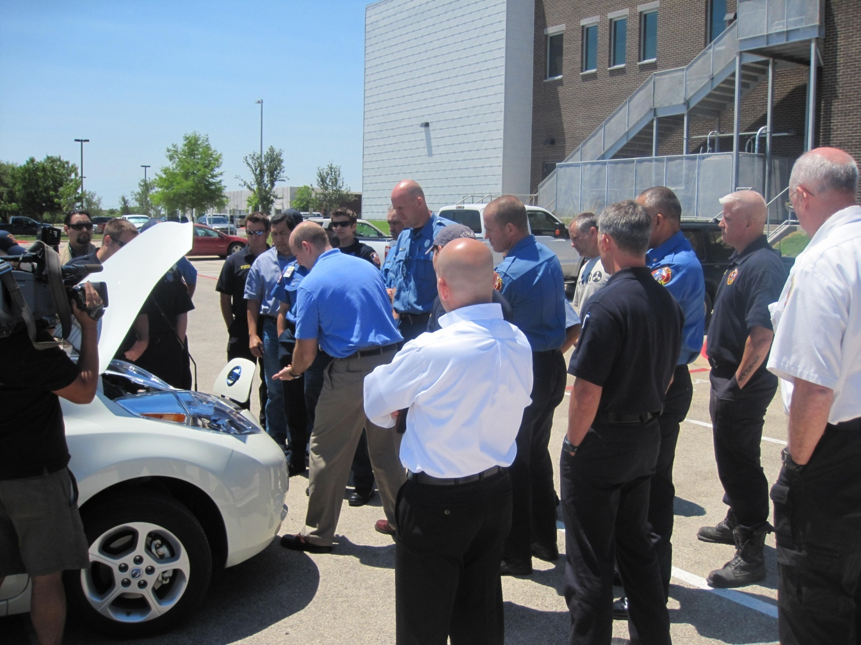
Fire Service State Trainings
34 States Trained
1900 Classroom Trainers trained – 11,000 Trained by Trainers
16,500 Trained Online
29,400 Total Fire Service Trained
North Carolina
New York
North Dakota
Oklahoma
Oregon
Pennsylvania
Rhode Island
South Carolina
Vermont
Washington
Wisconsin
Wyoming
Tennessee
Louisiana
Mississippi
Nevada
Texas
Arizona
California
Connecticut
Delaware
Florida
Georgia
Hawaii
Illinois
Iowa
Kentucky
Louisiana
Maryland
Massachusetts
Michigan
Missouri
Montana
New Hampshire
New Jersey

Slide 7
EV Safety Training Products
Fire Svc Train-the-Trainer Course
1,900 Fire Service Instructors Trained
Fire Service Classroom Course
11,000 Fire Service Trained
Fire/EMS Web Self-Paced Courses
16,500 Emergency Responders Trained
LE & EMS Classroom Course
LE & EMS Web Self-Paced Course
Emergency Field Guide
3,200 Distribution this year
EV Monthly Newsletter
25,000 Circulation
EV Safety Training Website
115,500 Visits

Slide 8
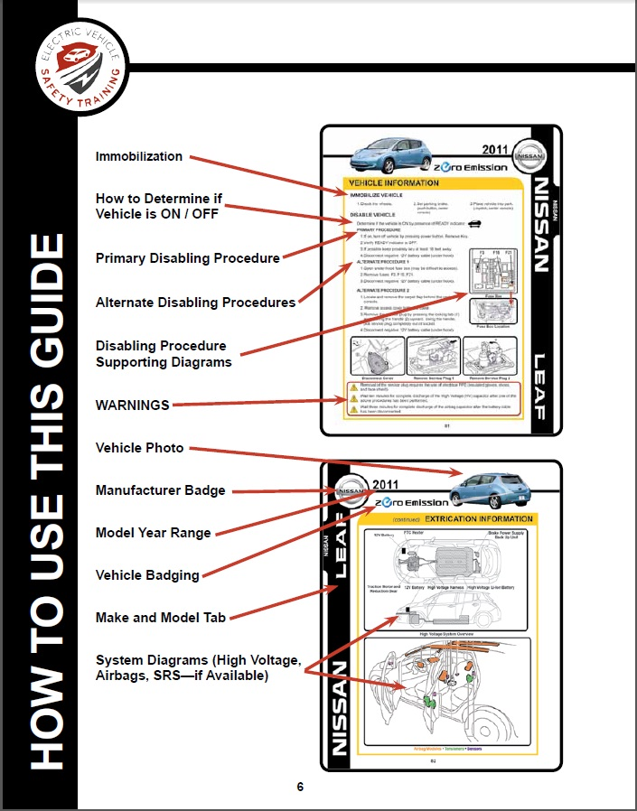
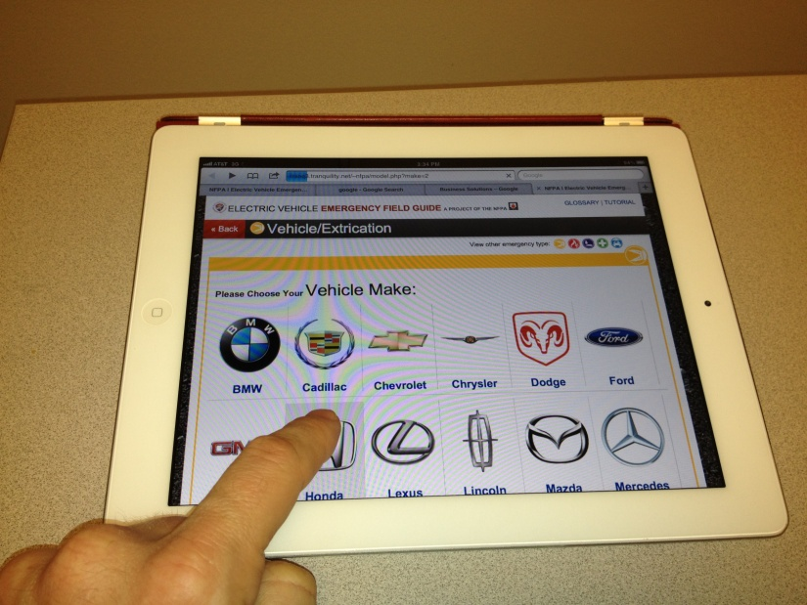
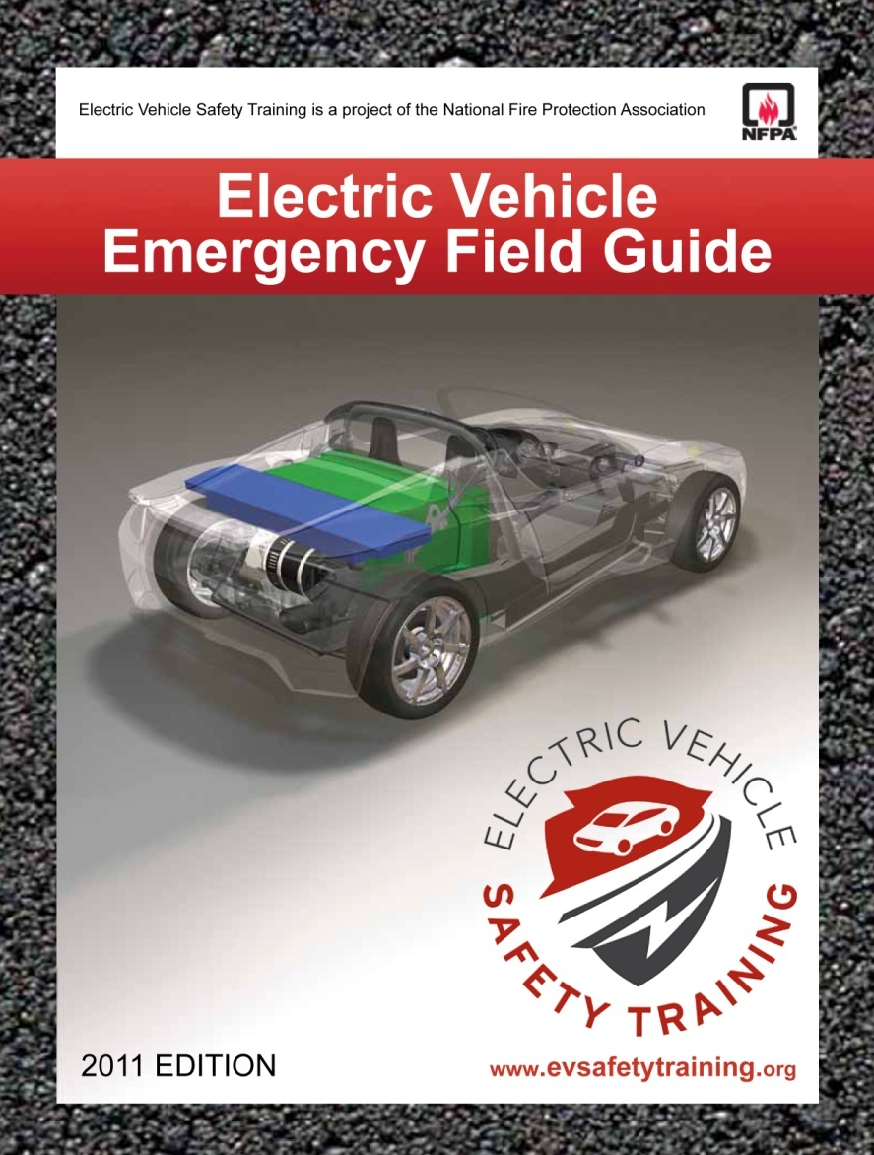
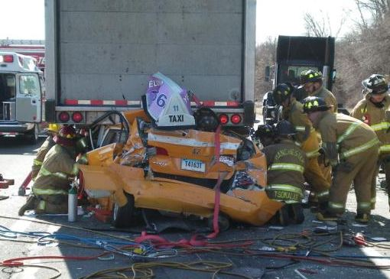
NFPA’s Emergency Field Guide

Slide 9
Integration with Outside Standards Initiatives
ANSI, Standardization Roadmap For Electric Vehicles
Single source for standards, works in progress and gaps.
SAE J2990, Hybrid and EV First and Second Responder Recommended Practice
Integration of NFPA Standards, EV Training Practices, and the SAE recommended practice.

Slide 10
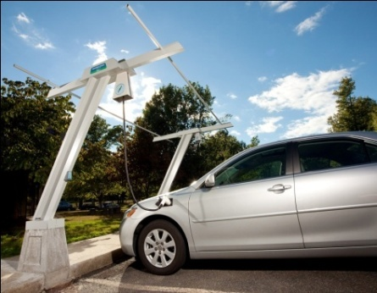
Electric Vehicle Safety Standards Summits
1st Summit: Detroit MI, Oct 21-22 2010
2nd Summit: Detroit MI, Sept 27-28 2011
3rd Summit: Detroit MI, Oct 17-18, 2012
Focused on:
Clarifying gaps with applicable codes and standards, and related activities
Improving dialogue among affected professional constituent groups
Co-hosted by NFPA and SAE
Reports available at: www.nfpa.org/foundation

Slide 11
Research and Data Gaps
Completed and Published Research Projects:
Evaluation of Powered Rescue Tools
EV Charging and Electrical Safety Codes
Proper Responder EV and Hybrid PPE
On-Going Research Projects
Evaluation of EV Battery Fires

Slide 12
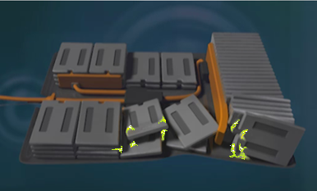
NHTSA Interim Guidelines for Li-Ion Vehicles
Watch for unusual
odors or eye, nose,
throat, or skin
irritation. If detected,
limit exposure and
evacuate.
Monitor HV battery for leaks, sparks,
smoke, flames or gurgling sounds.
Notify all responders and the manufacturer.
Follow local medical protocols in the event
of exposure to electrolyte or fumes.
5-12

Slide 13
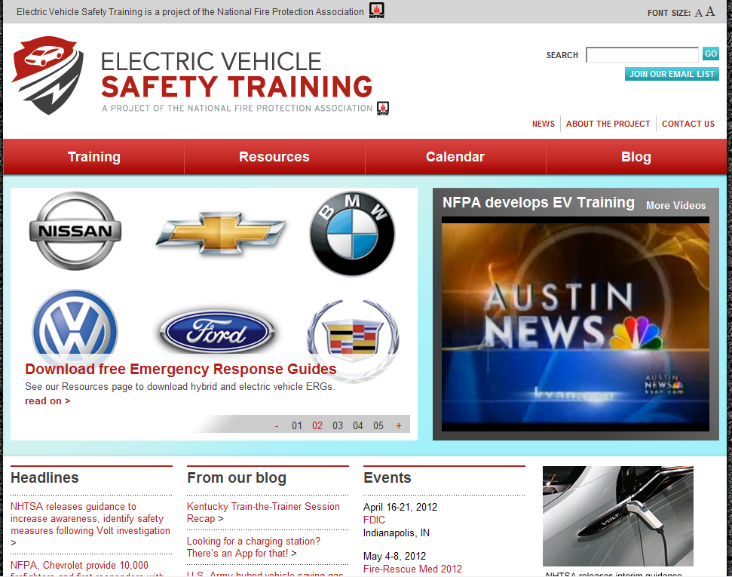
EVsafetytraining.org
115,500 Web Page Visits / 30,572 Blog Visits
25,000 EV Monthly Newsletter Circulation

Slide 14
Communicating with First Responders
In addition to the trainings, EV safety tips and resources have been shared via media channels
More than 100 stories(CNN, USA Today, MSNBC.com, NPR, TreeHugger, Firehouse, FireRescue1)
Both fire trade and traditional media
88 media outlets covered
50,694,450 earned media impressions

Slide 15
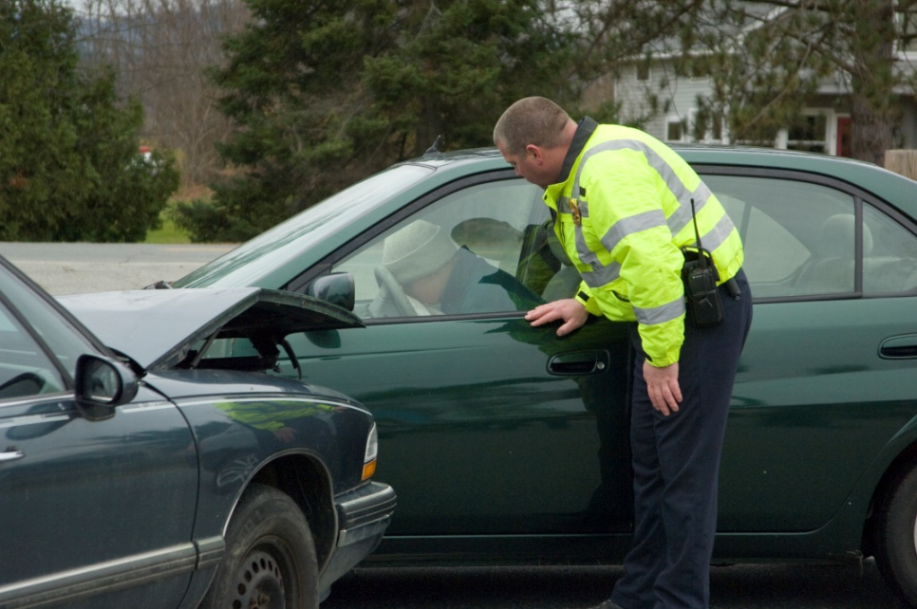
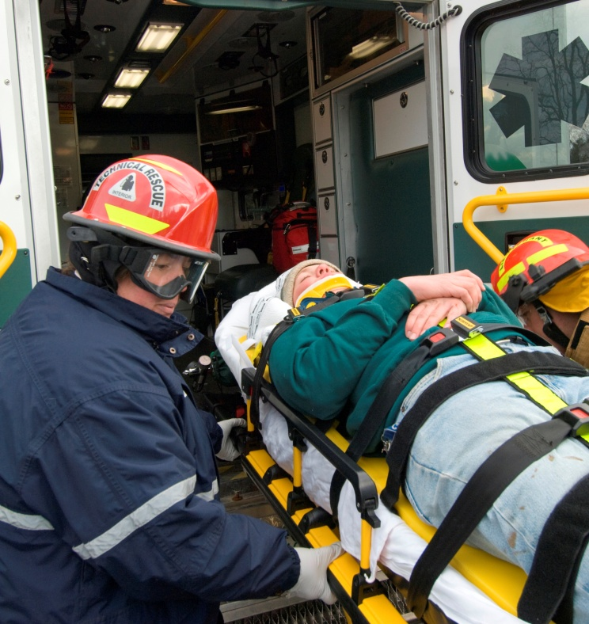
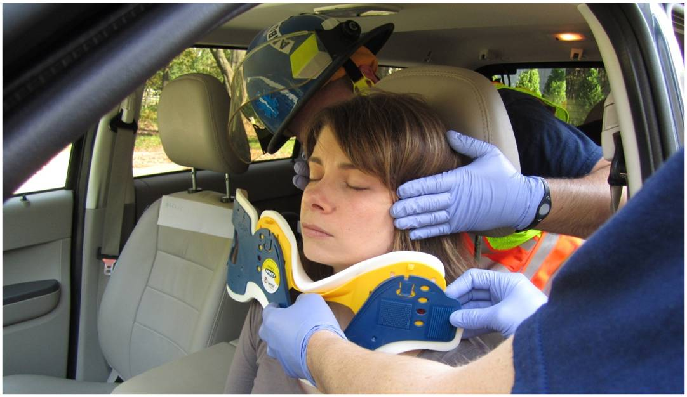
Law Enforcement & EMS Training
Pilot Program with NY State Police
Law Enforcement & Collision Reconstruction/Investigators EV Course
EMS EV Safety Course
Release date: August 2012

Slide 16
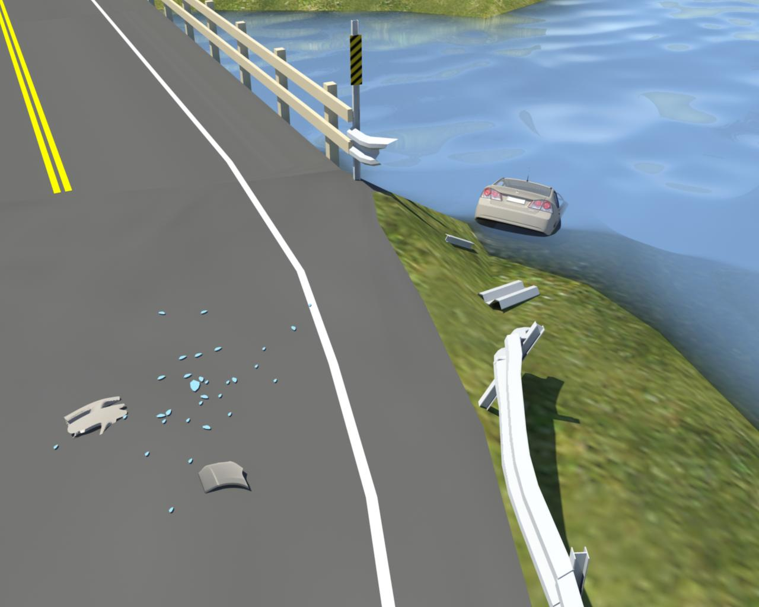
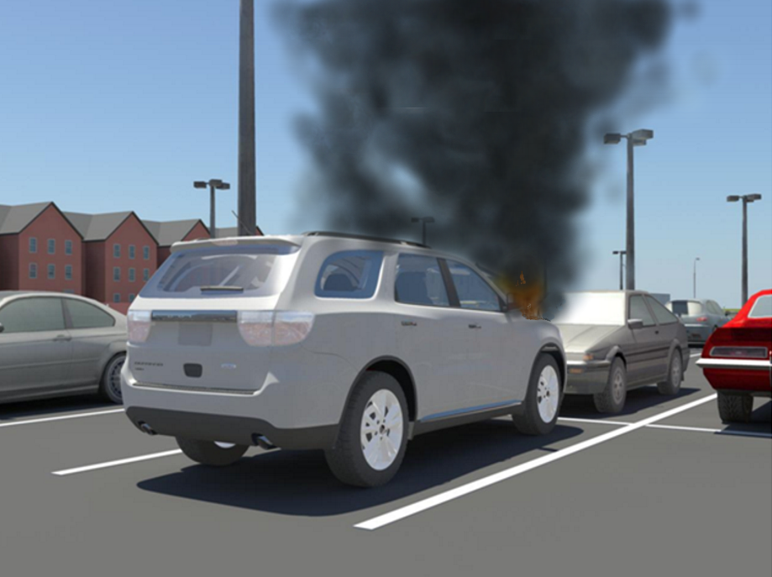
For More Information:
NFPA:
Christian Dubay, P.E.
Vice President & Chief Engineer
Email: cdubay@nfpa.org
Phone: (617) 984-7340
Please Visit NFPA’s EV Safety Website:
www.EVSafetyTraining.org

